Slide 1
Evaluating Predictions
Saryu Onishi
HES 3000-002, Sport Performance Analytics

Slide 2
What We Can Do Already
Choose variables and create a scatterplot.
Describe the direction and strength of a relationship.
Use a trendline equation to make a prediction.

Slide 3
Review: Correlation vs Prediction
Correlation: How strongly do the variables move together in a linear pattern?
Regression: What outcome does the fitted line predict for a given input?
Correlation is symmetrical, prediction is directional

Slide 4
Prediction Has a Direction
Outcome ~ Predictor
Outcome on the y, predictor on the x.
Do these two models answer the same question?
  points ~ fouls
  fouls ~ points
Why would you expect them to be related?
  points ~ assists
    Can describe how assists relate to points
    Cannot be used to conclude more passing = more points

Slide 5
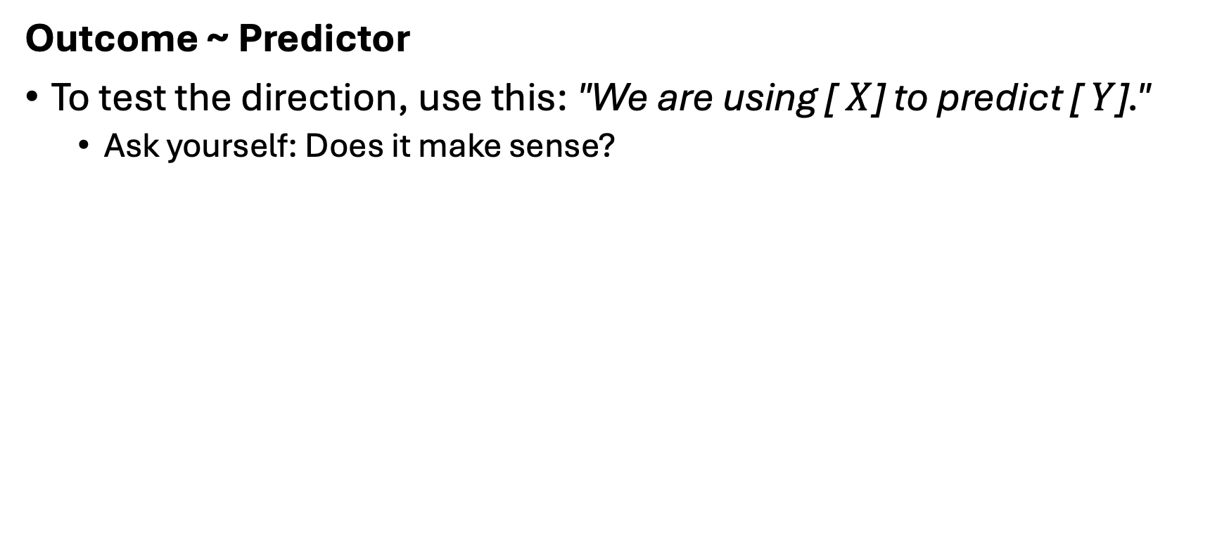
Prediction Has a Direction
Outcome ~ Predictor
To test the direction, use this: "We are using [ $X$] to predict [ $Y$]."
  Ask yourself: Does it make sense?

Slide 6
Trend line vs regression
Notes:
Mean vs. median decision-making (most frequent, and conceptually foundational)
Graph selection and matching to variable type
Describing a distribution in words
Excel selection and formula demo (quick and practical)

Slide 7
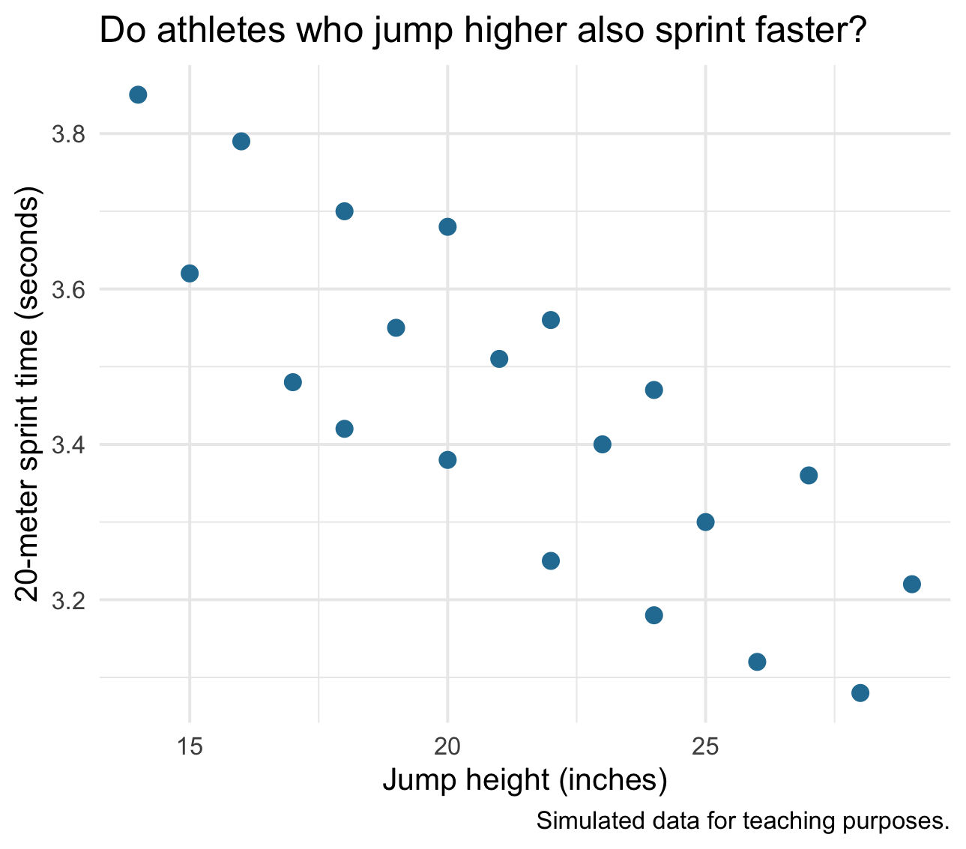
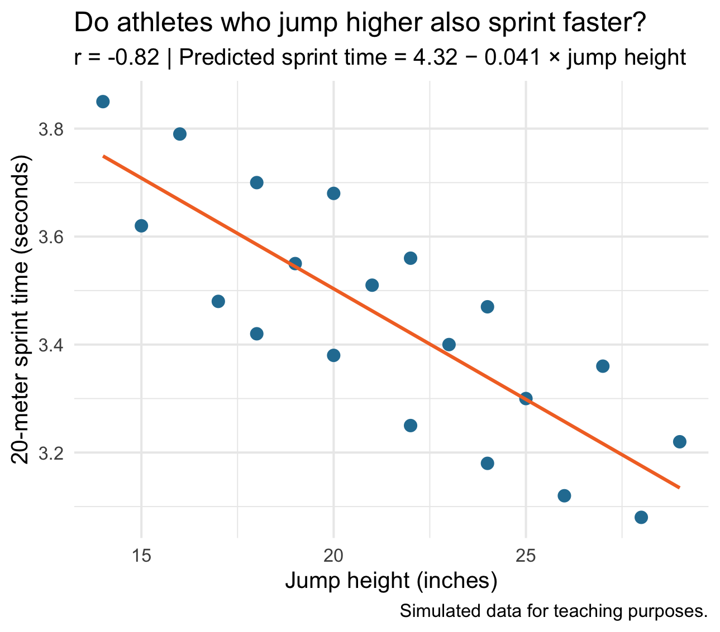
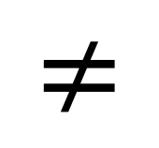
Trend Lines vs. Regressions
A trend line is NOT the same as a predictive model, It is a descriptive visual summary of the pattern.
A regression model (simple linear regression) uses a statistical method.
$$≠$$

Slide 8
Trend Lines vs. Regressions
A trend line is NOT the same as a predictive model, It is a descriptive visual summary of the pattern.
A regression model (simple linear regression) uses a statistical method.
BUT
Excel’s linear trendline uses statistical methods to fit the trend line by minimizing the residual
The displayed equation lets us calculate predicted outcomes.

Slide 9
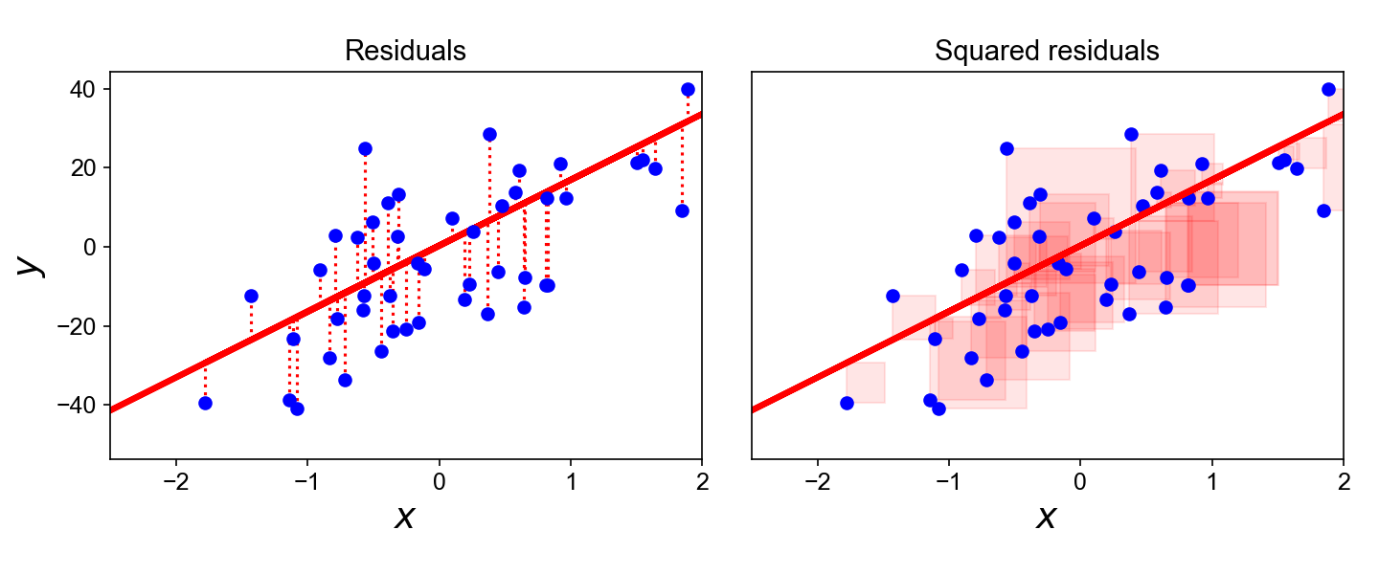
Minimizing the residuals
Residual = Actual – Predicted
Positive: Actual outcome is above the prediction.
Negative: Actual outcome is below the prediction.
Example:
  Predicted wins = 43
  Actual wins = 48
  Residual = +5 wins
Notes:
The way excel does this…

Slide 10
OLS Regressions
Ordinary Least Squares (OLS) chooses the slope and intercept that minimize the sum of squared residuals.

Slide 11
Correlation vs Determination
Notes:
Mean vs. median decision-making (most frequent, and conceptually foundational)
Graph selection and matching to variable type
Describing a distribution in words
Excel selection and formula demo (quick and practical)

Slide 12
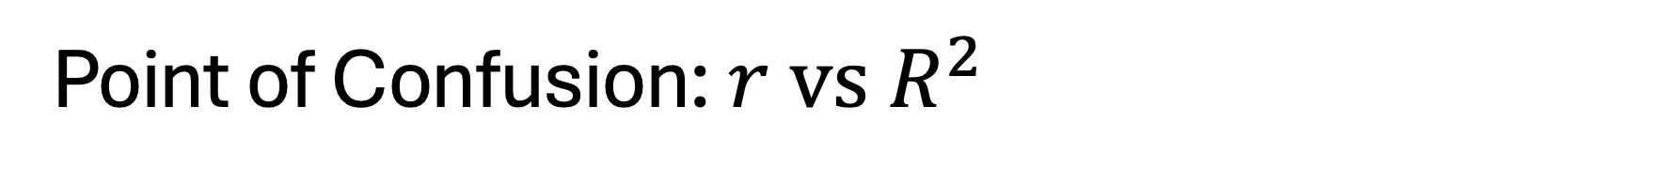
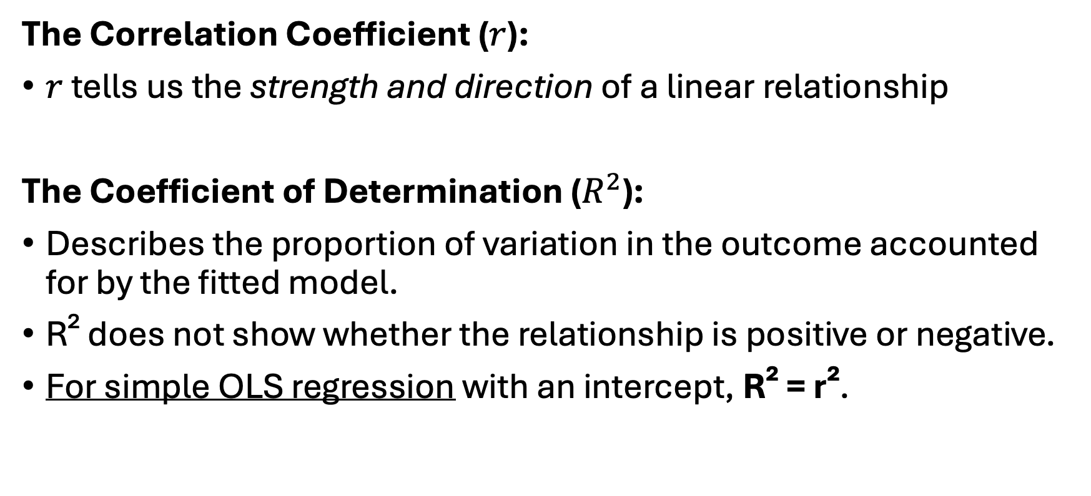
Point of Confusion: $r vs R^{2}$
The Correlation Coefficient ($r$):
$r$ tells us the strength and direction of a linear relationship
The Coefficient of Determination ($R^{2}$):
Describes the proportion of variation in the outcome accounted for by the fitted model.
R² does not show whether the relationship is positive or negative.
For simple OLS regression with an intercept, R² = r².
Notes:
If $r=0.7$, $r^{2}=0.49$, our model only explains 49% of the variation. Over half of what is happening on the court/field is driven by factors our model completely ignores.

Slide 13

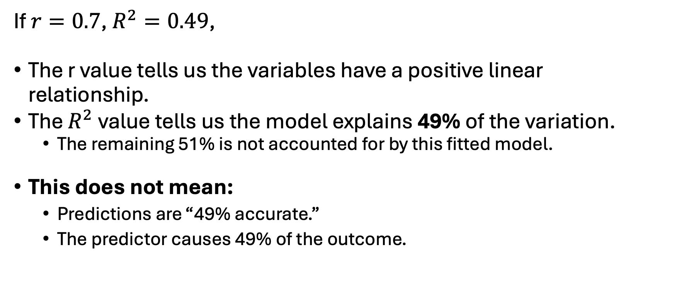
Interpreting $r vs R^{2}$
If $r=0.7$, $R^{2}=0.49$,
The r value tells us the variables have a positive linear relationship.
The $R^{2}$ value tells us the model explains 49% of the variation.
  The remaining 51% is not accounted for by this fitted model.
This does not mean:
  Predictions are “49% accurate.”
  The predictor causes 49% of the outcome.

Slide 14
Putting it all together
Direction: What are we predicting, and from what?
r: How strong is the linear relationship?
Slope: How does the predicted outcome change as x increases?
R²: How much variation does the model account for?
Prediction: What outcome does the equation give for a chosen x-value?

Slide 15
Uncertainty in Predictions
Common limitation to analysis

Slide 16
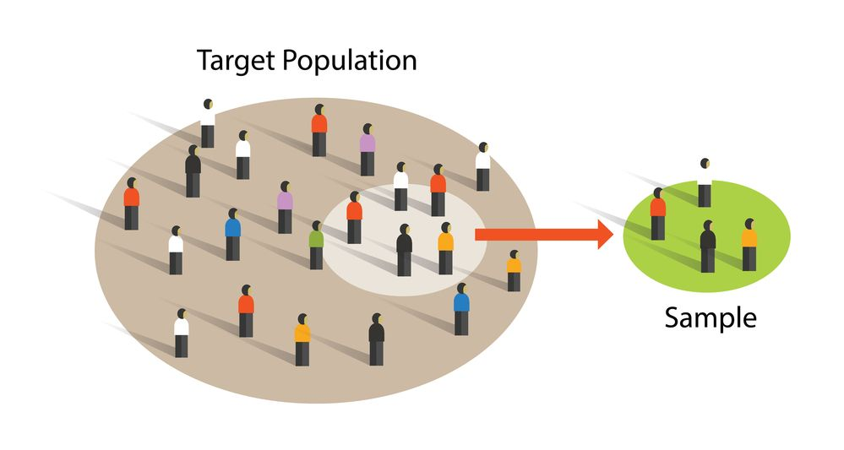
Sample Size
In sports, sample sizes can tiny (for team level analysis, n can be 8~12)
In small samples, one outlier can have a large influence a trendline
More observations generally help us estimate the relationship more reliably, but sample size alone does not guarantee useful predictions.

Slide 17
Generalizability
Models are most defensible when applied to athletes and situations similar to those in the original data.
  Population: A model developed with elite male sprinters may not perform well for youth female distance runners.
  Extrapolation: Predicting for a 36-inch jump when the observed range was 15–28 inches extends beyond the evidence.
  Context: Relationships measured on a laboratory treadmill may differ during outdoor competition.
What is the specific context for case study 3?

Slide 18
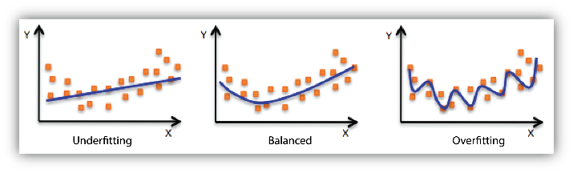
Overfitting
Underfitting: Model is too simple
  Misses the true trend.
Good Fit: Captures the core underlying athletic pattern (the signal).
Overfitting: Model fits every tiny detail (the noise)
  Fits existing data very closely, but may predict new observations poorly.
More is not better

Slide 19
Other contributing factors
A single predictor will not capture everything related to the outcome.
Eg: payroll may help predict wins, but injuries, player availability, and coaching may also matter.
Factor A
Factor B
Outcome
Factor C

Slide 20
Check Before Using the Model
Does the prediction answer our question?
Does a straight line reasonably describe the pattern?
How widely do observations scatter around the line?
Are we applying it to a comparable athlete or situation?
Is the input within the range represented in our data?

Slide 21
Summary
Prediction direction: Define what we predict and what we use to predict it.
OLS and residuals: Fit the line and describe its misses.
r and R²: Describe linear association and variation accounted for.
Using the model: Consider the sample, data range, and sporting context.

